Slide 1
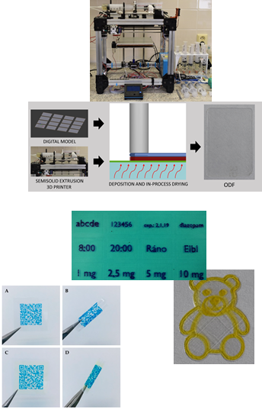
Drug Forms for Personalized Medicine
doc. PharmDr. Jan Gajdziok, Ph.D.
Aims:
using of 2D and 3D (SSE) methods for preparation of modern drug forms tailored for individual patient
high degree of flexibility of designed drug form (film, implant, etc.) in the field of drug dosage, combination of drugs, the size of the dosage form, etc.
introducing new functionalities ("smart"), taste masking, increasing patient compliance

